Slide 1
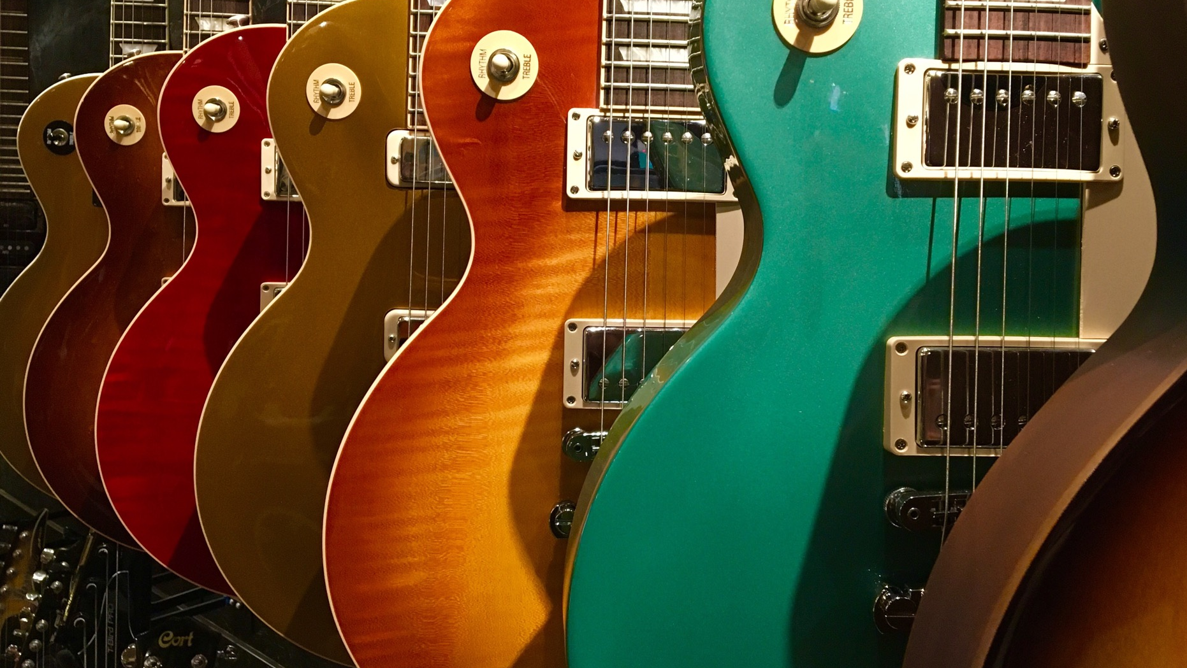
In Search of The Forth Chord
Software Architecture for the Rest of Us

Slide 2
Introduction
Software architecture is a complex topic
There are some repeatable patterns
Every system does not need to be (and should not be) a unicorn that only you understand

Slide 3
What is Software Architecture?
Non-functional requirements
Documentation
Politics
Testing
Notes:
Non-functional requirements – Software speed, reliability, scale, speed to market
Documentation – ADRs, where are the docs, what is documented and how? Who is responsible
Politics – Can’t just ask which NFRs you want

Slide 4
Who is a software architect?
In the absence of an explicit software architecture, the person that is writing the code is the architect

Slide 5
What problems are we trying to solve
Software Speed
Responsive / latency
Throughput
Capacity
Scale
Concurrency
State
Reliable
Usable
Availability
Secure
Speed to Market
Maintainable
Portable
Flexible
Extensible
Supportable
Deployable
Testable

Slide 6
What problems are we trying to solve?
Software Speed – you want you program to run quickly
Scale – you want your software to accommodate many users
Reliability – you want your software to be reliable
Speed to Market
How quick? What does quick mean?
How many?
What’s an acceptable downtime? Cost of unavailability
Timeframe
Notes:
99.9% uptime = 44 minutes downtime per month
99.99% uptime = 4.38 minutes downtime per month

Slide 7
Speed
Benchmark – how fast do you need and why
What needs to be fast – does the system really need to be fast, or just responsive?
Efficient
Responsive
Usable
Operable

Slide 8
Scale
What kind of scale are we talking – users and percentage
A 1 user system scaling to a 10 user system is an increase of 1000%
A 1,000 user system scaling to a 5,000 user system is an increase of 500%
Is the scale in peaks (e.g. Black Friday)
Available

Slide 9
Reliable
What do we mean by reliable?
Is available and usable
Has no faults
Secure
Is it also
Supportable and supported
Tested (all software is tested)
Integrity
Accuracy
Fault tolerant
Recoverable
Stable
Usable
Testable
Observable
Supportable

Slide 10
Time to Market
Deployable
Software must be easily deployed
Flexible
Must be easy to make changes
Compliant
Deployable
Composable
Interoperable
Easily Testable
Notes:
All software is testable – it’s just who tests it

Slide 11

Decision Time
What characteristics are important to the successful use of the system
Who can make that decision
Once a decision has been made – it should be documented
ADR
Wiki
Discussion Boards (not Teams)

Slide 12
Caveat
Nothing is free
Can’t (and shouldn’t) be applied to everything
Some of these patterns require significant investment and a change in approach

Slide 13

Three Chords

Slide 14
Using an Event Broker
Event Driven Systems
Microservices
Queues
Pub / Sub

Slide 15
Logical Coupling
Service 1
Service 2
Must know what the service is (REST / SOAP)
Must know where the service is (https://www.myapi.com/blah)
Must know what the service does (Accepts customer details and returns acknowledgement that the customer is created)
Notes:
Default communication method is something like an API call
Service 1 calls Service 2 directly, that means…

Slide 16
Logical Coupling - Example
CRM Back End
Customer Service
{
“CustomerName”: “Smiths”,
“CreatedBy”: “Someone”,
“OpeningBalance”: “10.00”,
“CustomerAddress”: “12 Palace Road, …”
}
CreateCustomer
{
“Successful”: “True”,
“RecordId”: “1234”
}
Notes:
Service 1 calls Service 2 directly, that means…

Slide 17
Logical Coupling - Example
CRM Back End
Customer Service
{
“CustomerName”: “Smiths”,
“CreatedBy”: “Someone”,
“OpeningBalance”: “10.00”,
“CustomerAddress”: “12 Palace Road, …”
}
CreateCustomer
{
“Successful”: “True”,
“RecordId”: “1234”
}
Notes:
Service 1 calls Service 2 directly, that means…
When Service 1 – or the CRM back end, called Service 2, or the Customer Service, it created a dependency – if service 2 changes, service 1 breaks

Slide 18
Temporal Coupling
Service 1
Service 2
Method1
Method2
Where a consumer must know the sequence in which the service requires methods to be called
Notes:
Method2 depends on Method1 being executed first

Slide 19
Temporal Coupling - Example
CRM Back End
Customer Service
CreateCustAddress
CreateCustomer
Where a consumer must know the sequence in which the service requires methods to be called
CreateCustomer requires an address record to be created

Slide 20
System Load
Service 1
Service 2
Service 1 calls Service 2 too frequently
Whilst Service 2 may be able to cope with the load, it may slow down
Service 1 may time out waiting for a reply

Slide 21

User Experience
User Interface
Service 1
Service 2
User places an order
Service 1 calls service 2 and waits for a response (maybe a stock check?)
Service 2 takes a while, by the time it responds the user may have lost patience, or even had the client time-out
Notes:
Talk about unstable internet connection (BB)

Slide 22
How Services Communicate
Service 1
Service 2
In a similar fashion to IoC, you do create a dependency on the broker itself
However, you can abstract this away to an extent
Notes:
At a really basic level

Slide 23
Logical Coupling
Services no longer need to know the location of other services.
Services will not directly break because data has been changed upstream.
Services are no longer dependant on the health of upstream services.
Services no longer care what up and downstream services do.

Slide 24
However
Services are now dependent on a message broker.
Although services will not directly break because upstream services have changed, if they are expecting data that has changed in format, they can still break.
Although a service may not care what up and downstream services do, those things still need doing.

Slide 25
Temporal Coupling
Still have a dependency on a sequence of events
Separating tasks into logical blocks linked by a message broker tends away from Temporal Coupling
Whilst each event may need to occur in a sequence, that sequence is not known to any single other process

Slide 26
System Load
Each service collects tasks as it is ready
The message broker acts as a shock absorber
Multiple services can deal with the same queue or topic
Load can be distributed across processes and therefore machines

Slide 27
User Experience
Fire and forget can lead to a worse (at least different) user experience
Response times are much faster, as you no longer actually wait for the response
But what if you need a response?

Slide 28

Demo – Message Broker
This Photo by Unknown Author is licensed under CC BY-SA
Notes:
Terminal:
docker run --rm -it --hostname my-rabbit -p 15672:15672 -p 5672:5672 rabbitmq:3-management
VS Code: SoftwareArchitectureTalk/MessageBroker.Send – dotnet run
SoftwareArchitectureTalk/MessageBroker.Receive – dotnet run

Slide 29
Store the Event History of the System
Event Sourcing
Store and process server-side events
Audit

Slide 30
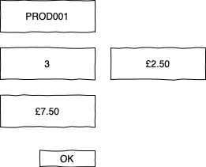
Event Sourcing Sales Order
Cancel Sales Order 12
New Sales Order 32
New Sales Order 31
Despatch Order 23

Slide 31
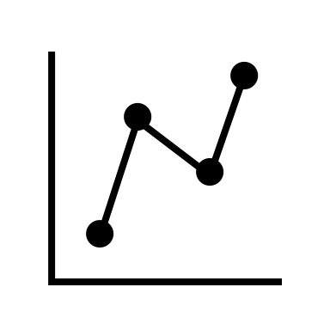


Event Sourcing
Auditing for free
Accurate log of everything that has happened to the system
Testing
Data Consistency
Startup Time
Complexity

Slide 32
Demo – Raven?

Slide 33
Separate Writes and Reads
CQRS

